Slide 1

Challenger SALE
Matt DIXON

Slide 4
X dv v

Slide 5
The challenger
Explained

Slide 6
The Challenger: Explained
the debaters on the team.
deep understanding of the customer’s business
Uses their understanding of the customer’s business to::
push the customer’s thinking
teach the customer something new about how their company can compete more effectively.
Challengers are not afraid to share their views, even when they’re different and potentially controversial.
Assertive: tending to “press” customers both on the customer’s thinking around things like pricing.
Challengers don’t reserve their Challenger mentality for customers alone, Sales Leaders can attest..
Challengers push their own leaders within their own organizations, tactfully, forcing people to think about complex issues differently..
As one member put it
“We have a handful of Challengers in our company, and almost. all of them seem to have a standing time slot on our CSO’s calendar to discuss what they’re seeing and hearing in the market. The CSO loves it. They’re constantly bringing fresh insight to the table that forces him to constantly check his strategy against reality.
Offers the customer unique perspectives
Has strong two-way communication skills
Knows the individual customer’s value drivers
Can identify economic drivers of the customer’s business
Is comfortable discussing money
Can pressure the customer

Slide 7
The Challenger: Explained
The Foundation
Unique perspective on the customer’s business
Their ability to engage in robust two-way dialogue
Challengers then teach for differentiation
Leveraging the foundation
Through a superior knowledge, and ability to communicate that knowledge of a customer’s economic and value drivers, they are able to:
Tailor for Resonance
Delivering the right message
To the right person within the customer organization.
Culminating and coming together . . .
Discussing money, when needed
Press the customer, when needed
Take control of the sale
Truly defined by their ability to do three things:
Teach
Tailor
Take Control
53% of customer loyalty is attributable to one’s ability to out perform the competition on the sales/purchasing experience

Slide 8
Teaching for differentiation
Tailoring for resonance
Teaching for differentiation is the ability to teach customers something new and valuable about how to compete in their market.
Our research on customer loyalty shows that this is the exact behavior that wins customers for the long term.
Teaching is:
Offering unique perspectives on the customer’s business
Communicating with passion and precision
Drawing the customer into the conversation
The perspectives do not immediately nor directly apply to the Challengers’ products/services
They are derived from, and apply first and foremost to how the customer can compete more effectively in their market.
Teaching becomes the insight customers can use to:
Free up operating expenses
Grow/Penetrate new markets
Reduced risk
Teaching Coreography
Identify unique benefits
Develop commercial insights that challenge customer thinking
Package commercial insights in compelling messages that “lead to”
Equip reps to challenge customers
While teaching is above all others . . .
the defining attribute of being a Challenger is the ability to tailor the teaching message:
to different types of customers
to different individuals within the customer organization
The Teaching Pitch requires tailoring.
Tailoring relies on:
the rep’s knowledge of the specific business priorities of the specific person, and persons they’re speaking with at any given moment
What these people value the most
the results they’re on the hook to deliver
the various economic drivers most likely to affect those outcomes.

Slide 9
Taking control of the sale
Assertiveness
Over pricing, and money
The customer’s thinking and the customer’s decision making cycle
“Stop wasting my time and teach me something new”
what sets the best suppliers apart is not the quality of their products, but the value of their insight.
INSIGHT is: new ideas to help customers either make money or save money in ways they didn’t even know were possible.
You will not win on the quality of the products, in a meaningful way at a meaningful scale, but instead through the quality of the insight you deliver as part of the sale.
the best reps win that battle not by “discovering” what customers already know they need, but by teaching them a new way of thinking altogether.

Slide 10
Commercial Teaching: Explained
#1: Lead to Your Unique Strengths
4 Key Rules
Lead to your unique strengths.
Challenge customers’ assumptions.
Catalyze action.
Scale across customers
It must tie directly back to some capability where you outperform your competitors. If what you’re teaching inevitably leads back to what you do better than anyone else, then you’re in a much better position when it comes to winning the business.
The sweet spot of customer loyalty is outperforming your competitors on those things you’ve taught your customers are important. But you’ve only really succeeded when the customer asks, “Wow, how can I make that happen?” and you’re able to say, “Well, let me show you how we’re better able to help you make that happen than anyone else.” That’s the magical moment.
Relevant insight
Tied that insight to your unique solution
Taught your customer not just to want help but to want your help
2 Important Caveats
You’ve got to make sure that you actually can help, versus, “teaching your customer into the desert.”
You actually have to know what your unique strengths are. Sure, it sounds obvious. As one marketing executive explained, “If I polled a hundred reps on our core value proposition, I’d get at least a hundred different answers.”

Slide 11
#2: Challenge Customers’ Assumptions
There’s vastly greater value in insight that changes or builds on what they know in ways they couldn’t have discovered on their own.
That kind of insight is not necessarily easy to achieve. You have to know your customers’ business better than they know it themselves.
It sounds like an impossibly high bar but the reality is that most suppliers actually do understand their customers’ business better than customers do themselves—when viewed specifically through the lens of that supplier’s capabilities.
Wherever the insight comes from, you’ll know if you’ve actually reframed your customer’s thinking based on their reaction. And this is where some reps really fall into a trap. Ironically, if your customer reacts to your sales pitch with something like, “Yes, I totally agree! That’s exactly what’s keeping me up at night!” well, then you’ve actually failed. you’ve found an issue or insight that resonates, but it doesn’t reframe. You haven’t actually taught them anything.
In a Commercial Teaching approach, this is exactly where we find the biggest difference between companies who believe they do this well and those who actually do this well.
#1 is about connection between insight and seller
#2 is about connection between insight and customer
Reframe
What data, information, or insight can you put in front of your customer that reframes:
The way they think about their business?
How they operate? How they compete?
Customers want a rep who:
Offers unique and valuable perspectives on the market
Helps me navigate alternatives
Provides ongoing advice or consultation
Helps me avoid potential land mines
Educates me on new issues and outcomes

Slide 12
#3 Catalyze Action
a well-executed teaching conversation isn’t about the supplier’s solution at all—at least not initially.
It’s about the customer’s business, laying out an alternative means to either save money or make money they’d previously overlooked.
In a conversation like that, traditional ROI calculations prove useless because they’re focused on the wrong thing. Nearly every ROI calculator we know of is built to help customers calculate the return on buying the supplier’s solution.
before you convince customers to take that action, you first have to show them why the insight you just shared with them merits any action at all.
To that end, the best ROI calculators in a teaching approach have nothing to do with your solution at all. Rather, they help customers calculate the costs they’re incurring or the returns they’re forgoing by failing to act on the opportunity you’ve just taught them they’ve overlooked.
If you’re going to build an ROI calculator, make sure it calculates the return on pursuing the reframe, not purchasing your products.

Slide 13
#4: Scale Across Customers
The common denominator for insight, in other words, isn’t geography or size, or industry. It’s a common set of needs.
The one thing every company that’s gone down this path has discovered is this: Needs analysis is not something you can afford to leave in the hands of your individual reps. If your reps’ primary goal going into a sales call is to “discover” the customer’s needs, you’ve lost the battle before you’ve even begun to fight, because, frankly, your customers don’t want to have that conversation.
Alternatively, Commercial Teaching equips reps to teach customers what they really need by challenging the way they think about their business altogether, providing them with new means to address their toughest problems in ways they would have never identified on their own.
Commercial Teaching must lead to your unique strengths, challenge customers’ assumptions, catalyze action, and scale across customers. but when these conditions are met, it works—phenomenally well, in fact. And the reason why, as we saw, is because more than anything else customers are looking to suppliers to challenge their thinking and teach them something they don’t know.
From a tactical perspective, it’s not realistic or fair to expect your reps to understand their customers’ business better than they do themselves without at least some organizational support.
For this approach to truly work, you need a small number of powerful insights that naturally lead to an even smaller number of unique solutions, all applicable across the broadest possible set of customers.
You need scale. Commercial Teaching is definitely not something you just want to leave in the hands of individual reps.
Commercial Teaching also requires you to think very differently about customer segmentation. While traditional segmentation schemes like geography, product silo, or industry vertical may be sufficient for sales rep deployment.
The companies that do best at this approach have learned to also segment customers by need or behavior. If you can find a group of customers with similar needs—irrespective of where they are or what they sell—those customers will likely all react in a similar fashion to a common set of insights.

Slide 14
Teaching Pitch: Summarized
what does a “teaching conversation” actually sound like?
It’s not just that Challengers teach that sets them apart, it’s the way that they teach that really matters most. World-class teaching conversations, it turns out, follow a very specific choreography, one that takes a traditional sales conversation and completely stands it on its head.
A very strong emotional component of a well-designed teaching pitch.
it’s about telling a compelling story.
there should be some real drama, perhaps a bit of suspense, and maybe even a surprise or two. U
the goal is to take customers on a roller-coaster ride
It starts with taking them to a rather dark place before showing them the light.
your story needs to engage both sides of the brain simultaneously—the rational and the emotional.
it’s too easy for your customer to make no decision even over a good decision, as logic alone is rarely enough to overcome the status quo. Disruptive change is as much about following your gut as it is about following your head.

Slide 15
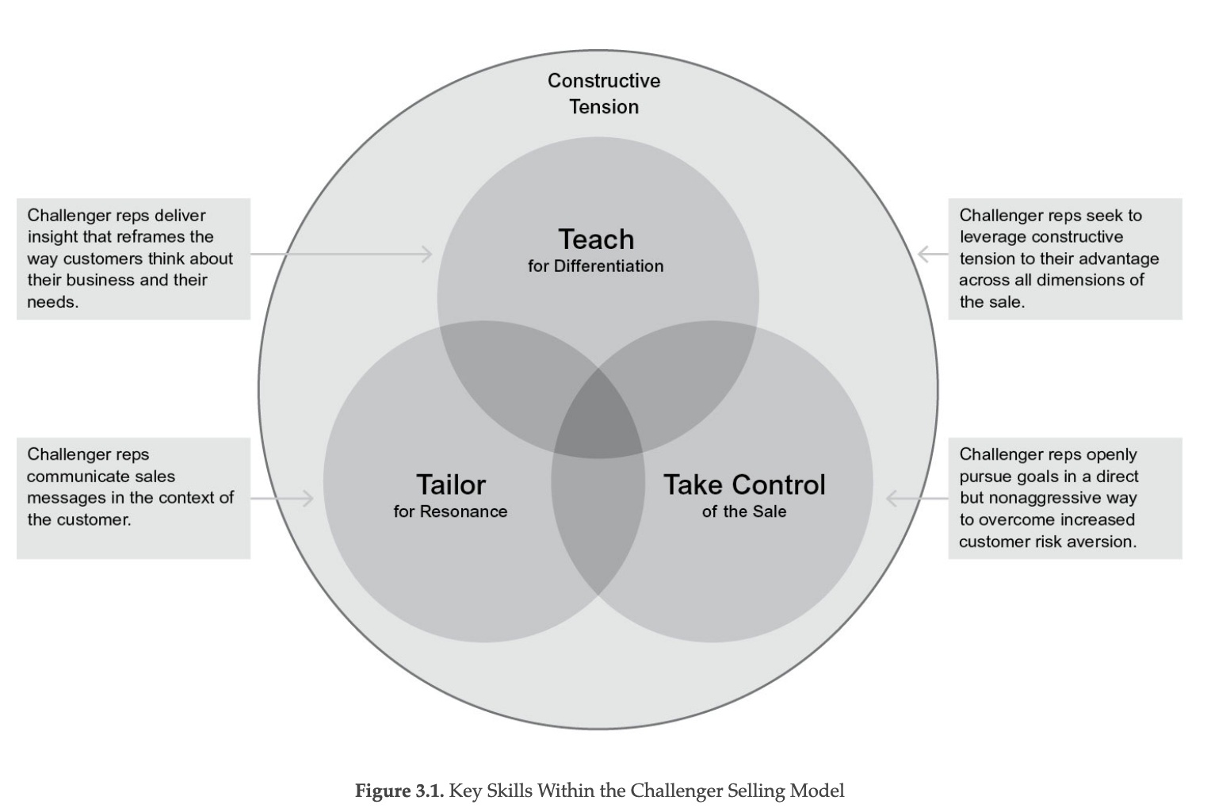
Teaching Pitch: Visualized

Slide 16
Teaching Pitch: Step #1
After initial formalities . . .
a well-designed teaching pitch starts off with your assessment of your customer’s key challenges:
Rather than asking, “What’s keeping you up at night?” you lay out what you’re seeing and hearing as key challenges at similar companies
provide benchmarking data.
At the very least, this is where you share anecdotes from other companies that capture the challenges most likely of highest concern to your customer in ways that corroborate their own experience.
  Do not underestimate the power of letting them
Get their reaction
It should look & sound something like . . .
“We’ve worked with a number of companies similar to yours, and we’ve found that these three challenges come up again and again as by far the most troubling. Is that what you’re seeing too, or would you add something else to the list?
Goal: build credibility.“I understand your world,” and “I’m not here to waste your time asking you to teach me about your business.”
“Hypothesis-Based Selling”: lead with hypotheses of customers’ needs, informed by your own experience and research.
Customers suffering from “solutions fatigue” love it not only because it makes the entire sale both faster and easier for them, but because it feels much more like a “get” than a “give”—they get your informed perspective rather than having to educate you with information you should have been able to figure out on your own.

Slide 17
Teaching Pitch: Step #2 The Reframe
Remember, the reaction you’re looking for here is definitively not, “Yes! I totally agree! That’s exactly what we’re working on!”
rather, “Huh, I never thought of it that way before.”
If your customer’s first reaction to your insight is enthusiastic agreement, then you haven’t actually taught them anything.
that’s a dangerous place to be.
Doing this is actually bad for two reasons.
if you fail to provide unique insight, then you fail to provide unique value.
if your customers have already begun to consider possible solutions, you’ve lost a significant opportunity to skew their thinking toward your solution.
it’s like failing to get ahead of the RFP:
You’re responding to customers’ needs
rather than defining them.
that’s a recipe for increased commoditization.
Building off the challenges the customer acknowledged in step 1 . . .
THE REFRAME
Intro a new perspective that connects those challenges to either:
a bigger problem
a bigger opportunity
than they ever realized they had.

Slide 18
Teaching Pitch: Step #3 Rational Drowning
Rational Drowning is where you lay out the business case for why the Reframe in step 2 is worth your customer’s time and attention.
It’s time for the data, graphs, tables, and charts you need to quantify for the customer the true, often hidden, cost of the problem or size of the opportunity they’d completely overlooked.
The numbers-driven rationale for why your customer should think differently about their business.
HOWEVER
Presented in a way designed to make them squirm a little bit—to feel like they’re drowning.
If your presentation is done well, the customer reaction in step 3 should be something like, “Wow, I had no idea we were wasting that kind of money!” or “I’d never thought of this as an opportunity before. We’ve got to get after this or we’re going to really miss out!”
In a world-class teaching pitch a good ROI calculator calculates the ROI on solving the challenge you’ve just taught your customer they have, not the ROI on buying your solution. If your ROI calculator is explicitly about your products and services—as it almost inevitably is—then you’re talking about the wrong thing.
Before you demonstrate how your solution can economically solve a key customer challenge, you’ve got to convince the customer that that challenge is worth solving in the first place.
Rational Drowning is where you lay out the business case for why the Reframe in step 2 is worth your customer’s time and attention: The numbers-driven rationale for why your customer should think differently about their business.

Slide 19
Teaching Pitch: Step #4 Emotional Impact
You’ve got to paint a picture of how other companies just like the customer’s went down a similarly painful path by engaging in behavior that the customer will immediately recognize as typical of their company.

Slide 20
Teaching Pitch: Step #5 A New Way
As tempting as it might be at this point to launch into a review of how you can help, step 5 is still about the solution, not about the supplier.
Facing a customer who enthusiastically agrees that they’ve got the very challenge your solution directly addresses, it is deeply tempting to talk specifically about how you can help.
For most reps it simply feels like the obvious thing to do.
But step 5 isn’t a story about how much better customers’ lives would be if they bought your stuff.
it’s about showing customers how much better their life would be if they just acted differently. It’s about behaving differently, not buying differently.
Don’t rush this.
Before they buy your solution,
the customer has to buy the solution.
Coming into step 5 you’ve convinced the customer of the problem.
Now you’ve got to convince them of the solution.
a point-by-point review of the specific capabilities they would need to have in order to make good on whatever the opportunity to make money, save money, or mitigate risk is, that you’ve just convinced them they’re facing.

Slide 21
Teaching Pitch: Step #6
This is where you lay out the specific ways you can deliver the solution they’ve just agreed to in step 5 better than anyone else.
This is where all of the hard work around identifying your unique capabilities pays off.
These unique capabilities are front and center in step 6.
If you want to teach customers something new, you’ll need to ensure that the “punch line” contains an element of surprise.
A new and unexpected way to think about how you can help.
Alternatively, if your customers already place high value on your benefits over those of the competition, you likely don’t need to teach them anything at all. Just take their order.
But beware: By focusing solely on the known value of your offering, you forgo an opportunity to challenge customers’ thinking
After that, it’s simply a matter of fleshing out the rest of the story to create a logical and compelling path from step 2 to step 6.
Put it all together and you get:
What’s currently costing our customers more money than they realize, that only we can help them fix?
The answer is the heart and soul of your Commercial Teaching pitch.
Step 5 is about getting customers bought in to acting differently.
Step 6 is about getting customers bought in on how your solution is best able, better than anyone else’s to equip them to act differently.

Slide 22
Building the Insight Generation Machine
1.
2. the conversation is prescripted. A teaching rep still has to interact with the customer in a live setting, answering questions and adapting to unanticipated objections. However, the rep’s opening set of hypotheses is already laid out in detail, and every step along the way is clearly marked through the teaching choreography. Because the teaching pitch follows the same talking points again and again, reps will naturally improve as they learn from experience, becoming more compelling over time.
Finally, the solution the rep is working toward is predefined. The burden on the Teaching choreography:
Identify your unique benefits.
Develop commercial insight that challenges customers’ thinking.
Package commercial insight in compelling messages that “lead to.”
Equip reps to challenge customers.
Commercial Teaching provides a road map for integrating around a limited number of activities that truly matter. The approach defines a very specific framework for “what good looks like” for the entire commercial organization, allowing for the identification of concrete roles, tasks, goals, and responsibilities.
For example, only marketing has the tools, the expertise, and the time to generate the insights necessary to challenge customers both scalably and repeatedly. As the head of marketing at a large telecommunications company put it, marketing must serve as the “insight generation machine” that keeps reps well equipped with quality teaching material that customers will find compelling.
Sales, on the other hand, will have to ensure that reps have the knowledge, skills, and coaching necessary to go out and use that insight in a convincing manner to actually challenge customers.
Commercial Teaching isn’t a one-time exercise, it’s an “always-on” capability. With input from the sales force—and at their behest—organizations must invest in training marketers to articulate differentiators and constantly source fresh and compelling teaching messages.
You need Challenger reps to deliver the teaching, but the actual construction of the conversation, the unique benefits, the surprising customer insights, the tightly packaged teaching choreography—require input from the entire commercial organization.
Many companies choose to shield sales reps from the complexity of the six-step choreography altogether. They simplifying the approach into 3 elements
Providing customers with game-changing insight
Specifying and personalizing the potential impact of that insights
Introducing your capabilities as the best possible means of acting on that insight.
It’s the same journey, but it’s simply easier to process for reps traditionally accustomed to “leading with” rather than “leading to.” These are organizational capabilities, not individual skills.
A critical lesson of the Challenger approach is the significant need for organizational involvement to make it truly sustainable. Few but the very best of your reps could pull off this kind of teaching on their own consistently over time.
With Commercial Teaching, you can significantly back off on your expectations for individual customization ability, as the organization steps in to offer crucial support around the very thing that customers have told us they value most in supplier interactions, namely the sharing of commercial insight.
The reps’ primary job shifts from discovering needs to guiding a conversation. That allows the organization to lay out the framework for that conversation in advance.
Customer’s needs are prescoped. Reps don’t start with a blank sheet of paper and diagnose each customer’s needs. individually. Much of that work has been done inside the organization through better segmentation and customer analysis, significantly reducing the burden on the one skill reps probably struggle with the most.

Slide 23
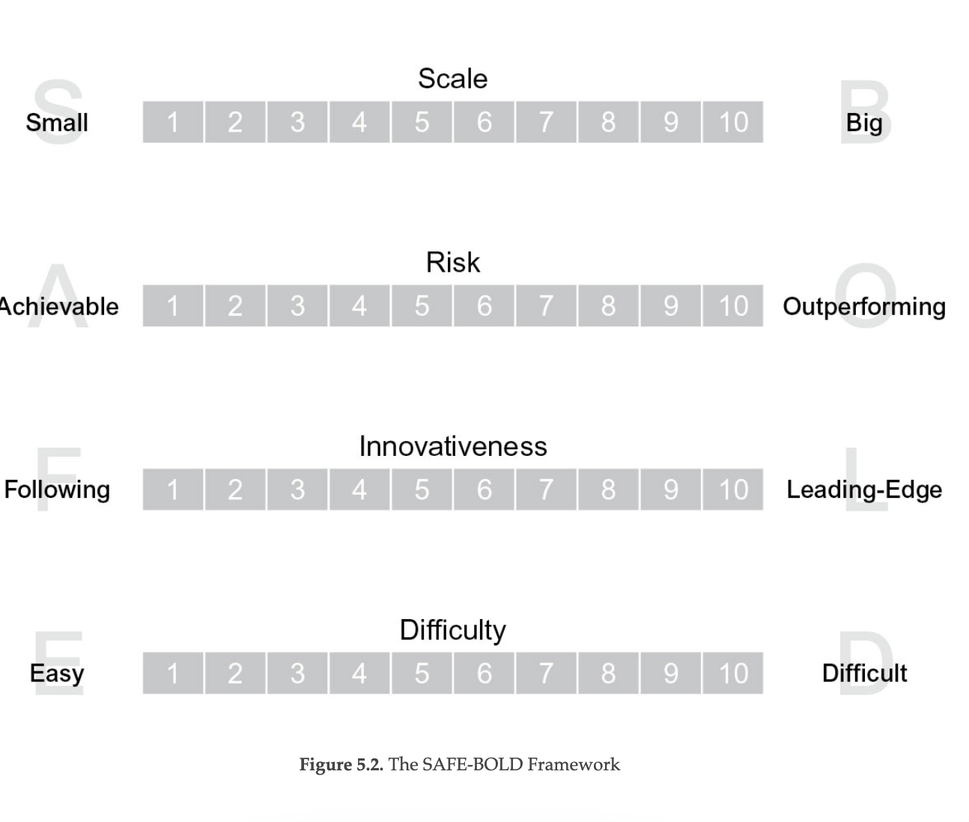
SAFE-BOLD Teaching
Figure 5.2. The SAFE-BOLD Framework
MAKE SURE YOUR TEACHING PITCH IS “BOLD”
We see a lot of companies slip into “safe mode.” it gets watered down to the point where it’s more of a suggestion than a provocation.
A great tool to ensure that teaching pitches don’t lose their edge is the “SAFE-BOLD Framework,” developed by Neil Rackham and KPMG.
“A successful teaching pitch must do four things well.
be big. Done well, it will be seen by the customer as more expansive and farther-reaching than an ordinary idea.
it must be innovative. It has to push the envelope with new, often untested and unique approaches.
it must be risky. Big ideas mean that we are asking our own companies and our customers to take a big risk in adopting our idea.
it must be difficult. The idea itself must be hard to do—either because of scale, uncertainty, or politics, otherwise, why would a customer hire you to fix it for them?

Slide 24
Tailoring for Resonance:
What Customers Really Want
Influencers
These influencers place much more emphasis on the individual rep selling to them.
End users don’t think of themselves as buying from organizations; they buy from people.
So what is it about the people they interact with that makes them more likely to be loyal?
See Figure 6.2 on Next Slide
Drivers of Sales Reps Loyalty for Influencers and End Users
Rep’s professionalism is the biggest driver of loyalty..
Customers are simply looking for a professional. Someone they can believe, and someone they can trust. This is likely a response to the typical over promising that reps engage in.
Right behind professionalism as predictor for success is: the ability of the rep to “offer unique and valuable perspectives”
Equal important as “unique and valuable perspectives“ is “frequently educate the customer on issues and outcomes.”
Decision Makers
Defined in our study as the people who actually sign the agreement.
Generally fall into one of 2 categories:
Senior executives
Procurement.
So what really matters to these senior buyers?
Aspects of the overall sales experience are nearly 2x as important as individual rep attributes.
They think of themselves as buying from organizations, not from individuals. So what does that mean
Price and customization are significantly less important than widespread support and ease of doing business. unlike decision makers
In other words, what you find is a whole set of high-scoring loyalty drivers around the rep’s ability to help non–decision makers recognize previously underappreciated or undervalued needs.

Slide 25
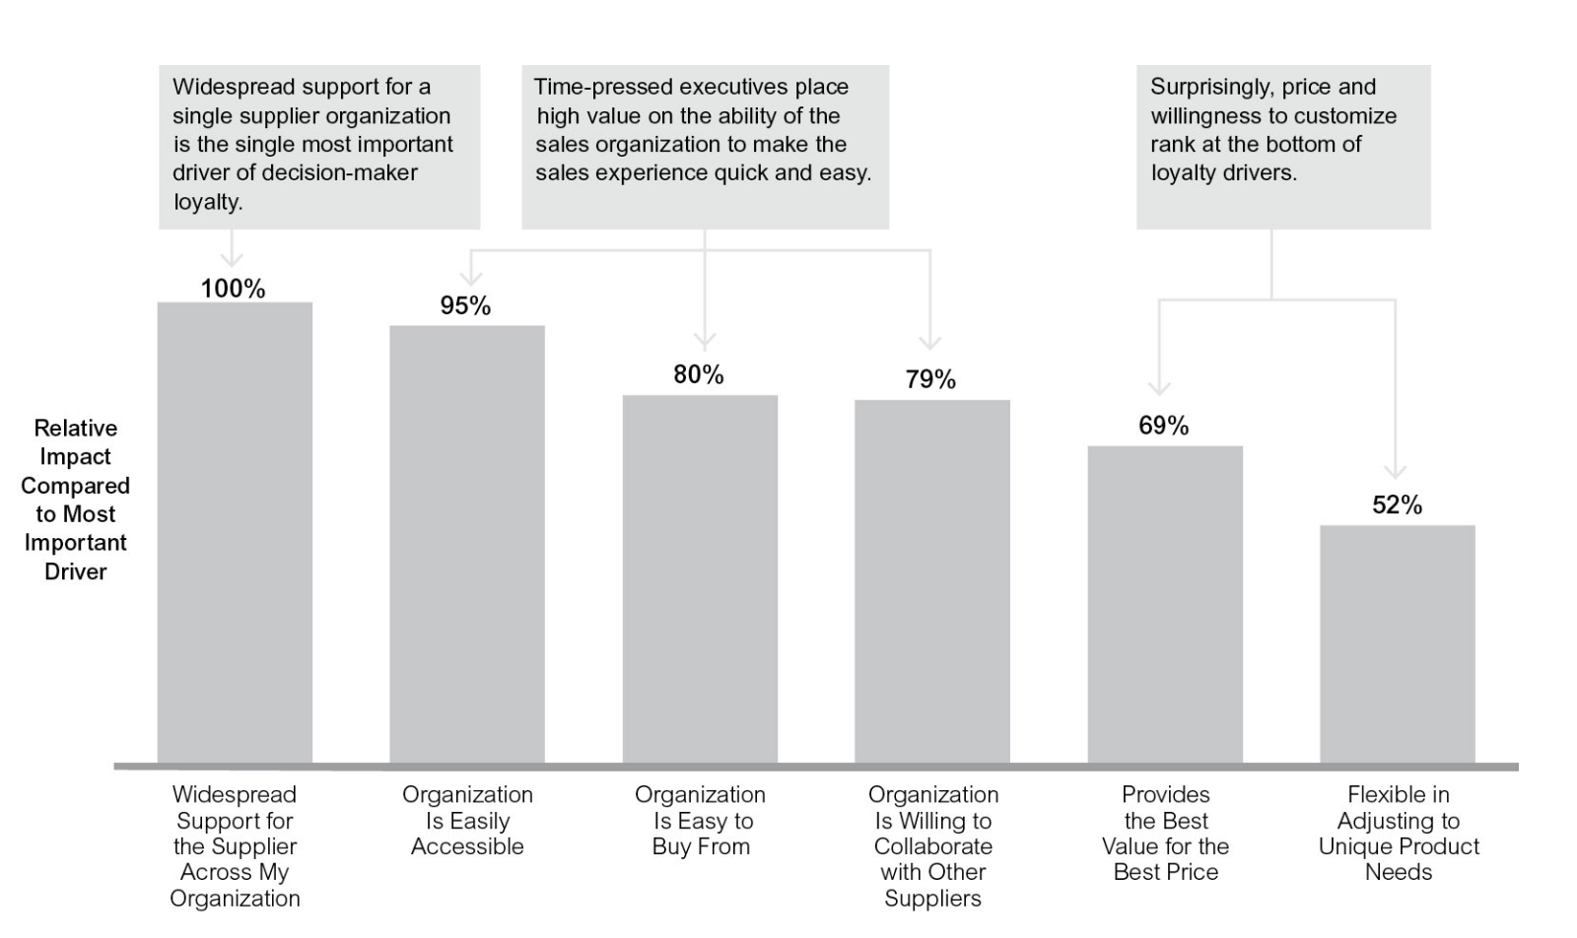
6.1 Sales Experience Drivers of customer loyalty - DMs

Slide 26
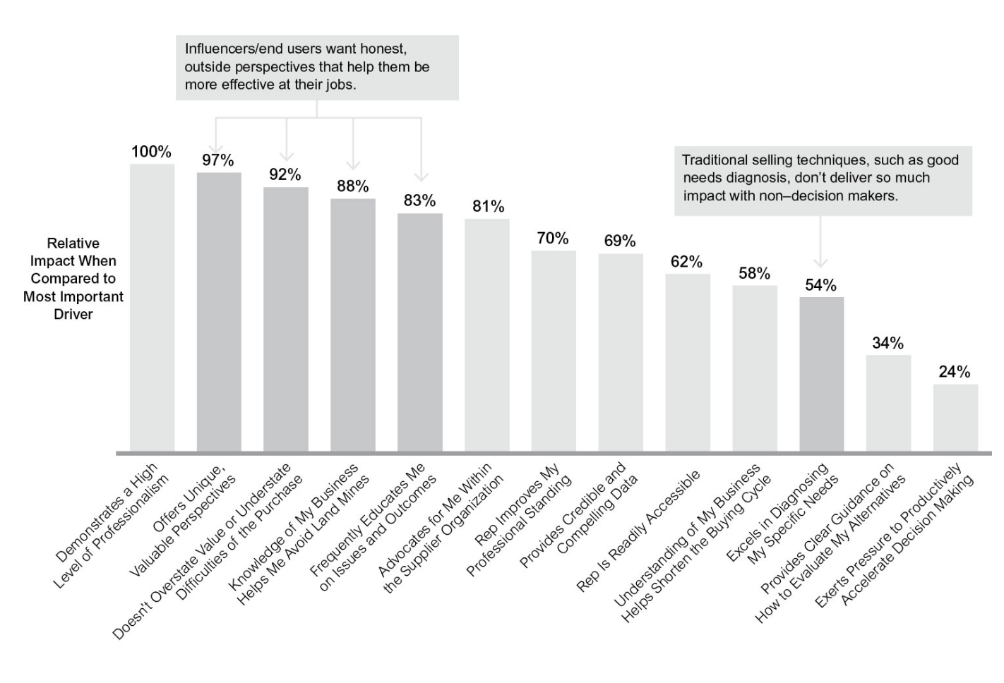
6.1 Sales Experience customer loyalty - Influencers

Slide 27
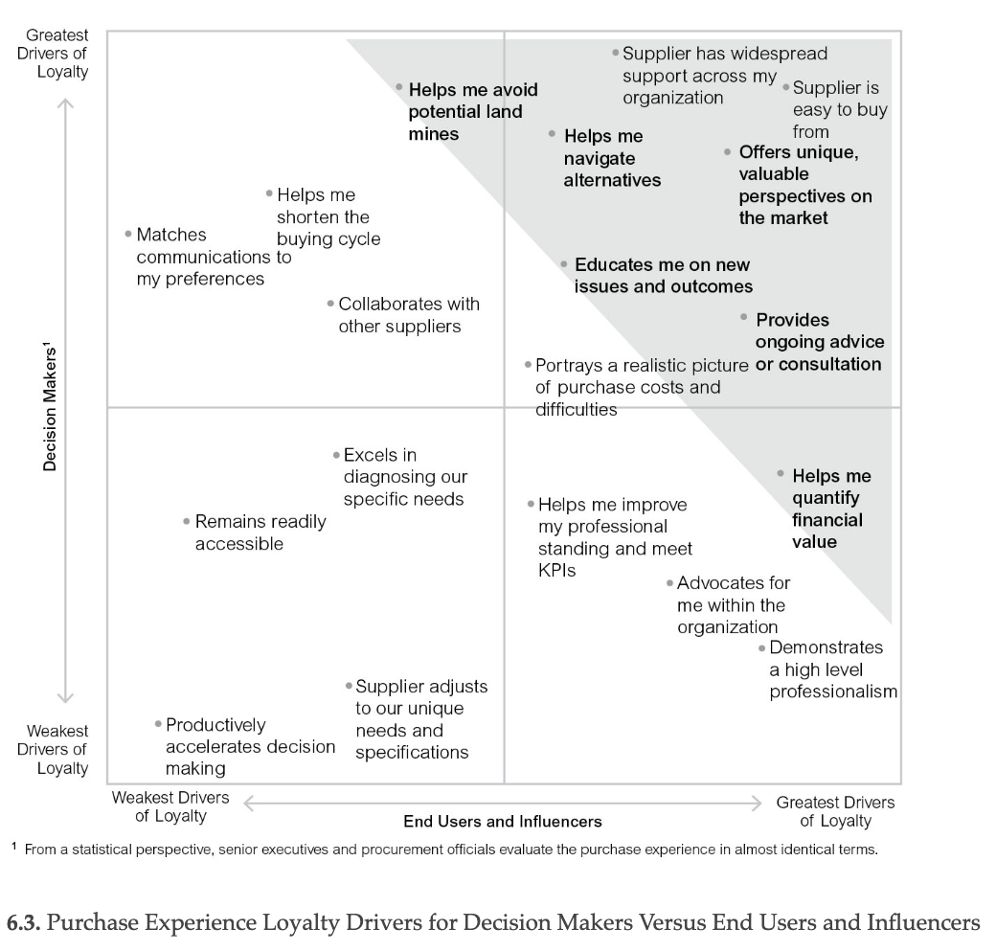
6.3 Purchase Experience Loyalty Drivers: DM vs. Influencer

Slide 28
Tailoring the Message
2 things Challenger reps tailor to are:
their knowledge of an individual stakeholder’s value drivers
an understanding of the economic drivers of that person’s business.
A Challenger rep arrives at the customer with a deep understanding of:
how individual stakeholders fit into their overall business
what their role is and what they are worried about
Their specific quantifiable results that those individuals want to achieve
Challenger reps aren’t focused on what they are selling,.
They are focused on what the person they’re speaking to is trying to accomplish.
The strengths of this approach are that needs across roles within similar companies remain relatively steady over time, and comparable organization.
what all of this means is that your reps now have to talk to more people than ever just to get the deal done
One of the biggest obstacles that core reps grapple with when it comes to dealing with a consensus-based buying environment is:
How to tailor the sales message to these different stakeholders in order to achieve maximum resonance.
Tailoring takes on many forms.
A good way to think about how to tailor messages is to:
Start at the broadest level, the customer’s industry
Then person’s company
Person’s role,
The individual person
Figure 6.5 “layers” of tailoring
The best thing about understanding and mapping customer outcomes is that you don’t have to rely on individual reps to figure all this out on their own.
This is something that can be determined centrally—in marketing or sales operations—and then given to your reps in the form of a tool.

Slide 29
Taking Control of the Sale
Challengers, by contrast, “lead and simplify.”
Rather than assuming that the customer knows how to execute the purchase of a complex solution, they teach the customer how to buy the solution.
They extrapolate from past successful sales efforts and apply what they’ve learned to help the customer work through their purchase process.
Instead of asking, “Who needs to be involved?” Challenger reps coach the customer on who should be involved.
Misconception #2: Reps Take Control Regarding Only Matters of Money
Need to establish credibility, authority, and develop customer appreciation for these new ideas as they are all critical to the eventual sale, otherwise it all falls apart, and as a result a rep needs to work on controlling early on.
Misconception #3: Reps Will Become Too Aggressive If We Tell Them to “Take Control”
3rd distinguishing characteristic of Challenger reps: Their ability to take control of the sale.
Challengers also create momentum, their deals don’t get stuck in no-decision because they will think ahead to the next steps.
3 misconceptions of taking control of the sale
Taking control is synonymous with negotiation.
Reps only take control regarding matters of money.
Reps will become too aggressive if we tell them to “take control.”
Misconception #1: Taking Control Is Synonymous with Negotiation
The typical rep response is spending time with the junior contact in the hopes of turning that individual into an advocate.
Challengers suss out these foils and require expanded access within the organization in exchange for more time.
Top performers extend this part of the sales process by digging into these individual stakeholders’ varying goals and biases, as well as business and personal objectives.
They map out not just who the key stakeholders are, but what these stakeholders care about and why they care about these things.
By doing this, the Challenger is in a much better position to be able to take control right from the beginning.

Slide 30
The Role of Leaders, The Team, & the Company

Slide 31
Equipping Reps to Take Control
How do companies shake reps out of their passive posture? Getting this right requires that they tackle the main obstacle that gets in the way of the average rep’s being
Challengers, by comparison, thrive in ambiguity. They know how to navigate it and understand how it can be leveraged to their advantage. They display a remarkable level of comfort with silence during the customer conversation, as well as with keeping negotiation points and customer objections open and on the table longer than one normally would. It might be a bit of an overstatement to say they “like” tension, but it probably isn’t that far from the truth.
helping reps to avoid premature closure.
Competition differentiation: The trick is not to describe your differences, but to make customers value them. And to do that, remember these two things:
be memorable, not agreeable: It’s nice to have a business conversation about profits and capabilities, or a relationship conversation around sports and kids, but unless you frame your conversation around an edgy or unique insight, the customer will forget everything you said as soon as you walk out the door.
  Being different sounds risky, but it’s better than being forgettable.
build a pitch that leads to your solution, not with it: Before even talking about your capabilities, teach customers about a problem They didn’t even know they had—one that you can solve better than your competitors. Only then should you lead into the details of your specific

Slide 34
X dv v

